Slide 1
Financial Management
Dr. Sarveshwar Kumar Inani
sarveshwarinani@wilp.bits-pilani.ac.in

Slide 2
Key Financial Statements
Managers, shareholders, lenders, suppliers, customers, tax authorities, and other interested groups seek answers to the following important questions about a firm:
What is the financial position of the firm at a given point of time?
How has the firm performed financially over a given period of time?
What have been the sources and uses of cash over a given period of time?

Slide 3
Key Financial Statements
To answer the above questions, Financial Accounting prepared the following three key statements
Balance Sheet: Shows the financial position of the firm at a given point of time
Profit and Loss A/C: Reflects the performance of the firm over a period of time
Cash Flow Statement: Displays the sources and uses of cash during the period.

Slide 4
Financial Statements
Provide information on how the firm has performed in the past and what is its current financial position.
Serve as a convenient device for the stakeholders to set performance norms and impose restrictions on the management of the firm.
Provide convenient templates for financial forecasting and planning.

Slide 5
Balance Sheet
Total Assets = Total Liabilities + Owner’s Equity
TA = TL + OE
Total Assets = Total Fixed Assets + Total Current Assets
Total Liabilities = Total Long-term Liabilities + Total Current Liabilities
Owner’s Equity = Shareholders’ Funds + Reserves and Surplus

Slide 6
Balance Sheet Format
Liabilities | Amt | Amt | Assets | Amt | Amt
Capital Share capital Retained earnings |  |  | Fixed Assets (less Depreciation) Land and Buildings Plant and Machinery Equipments
Long-term Liabilities Debentures Bonds Long-term loans |  |  | Current Assets Cash Bank Marketable securities Accounts receivables (Debtors) Inventories Prepaid expenses
Current Liabilities Accounts payables (creditors) Taxes payables Accrued expenses Deferred revenues Current portion of long-term debt |  |  | Other Assets Investments Intangible assets

Slide 7
Profit and Loss A/C
Profit After Tax (PAT) = Revenue – Expenses
Based on the two important principles of Accounting
Recognition Principle: Revenue is recognized when the transaction generating the revenue takes place.
Matching Principle: The expenses associated with a product/service are recognized when the product/service is sold

Slide 8
Profit and Loss A/C Format
Particulars | Amount | Amount
Sales |  | XXX
(less) Cost of Goods Sold |  | XXX
Gross Profit |  | XXX
(less) R & D Expenses Sales & Distribution Expenses Administration and General Expenses | XXX XXX XXX | XXX
Operating Income (EBITDA) |  | XXX
(less) Depreciation and Amortization |  | XXX
EBIT |  | XXX
(less) Interest |  | XXX
EBT |  | XXX
(less) Tax |  | XXX
EAT or PAT or Net Profit |  | XXX

Slide 9
Cash Flow Statement
The Cash Flow Statement reflects an enterprise’s major sources of
Cash Receipts, and
Cash Payments.
It reports the cash effects during a period of an enterprise’s
Operations,
Investing transactions, and
Financing transactions
It focuses on
Aggregate of cash and
Cash equivalents

Slide 10
Cash Flow Statement Format
SN | Particulars | Amount | Amount
(a) | Cash Flow from Operating Activities List of individual inflows and outflows Net cash provided by/used in Operating Activities | XXXX | XXXX
(b) | Cash Flow from Investing Activities List of individual inflows and outflows Net cash provided by/used in Investing Activities | XXXX | XXXX
(c) | Cash Flow from Financing Activities List of individual inflows and outflows Net cash provided by/used in Financing Activities | XXXX | XXXX
(d) | Net increase/decrease in cash (a+b+c) |  | XXXX
(e) (f) | Cash and cash equivalents, beginning of period Cash and cash equivalents, end of period (d+e) |  | XXXX XXXX
 | Schedule of non-cash investing and financing activities List of individual transactions

Slide 11
Why Financial Statement Analysis?
Trend of revenue/profits/margins (CAGR)
Trend of Assets/Cash flow/Liabilities
Investors/Lenders take decisions based on FSA
Comparison of firm with industry standards
Commentary about Profitability, Liquidity, Efficiency, Solvency, and Valuation of the company (Ratio Analysis)
Evaluate past performance
Predict future performance

Slide 12
Financial Statement Analysis Techniques
Financial Ratio Analysis (including Dupont analysis)
Horizontal and Trend Analysis
Vertical (Common-size) analysis
Industry benchmarking Analysis

Slide 13
Financial Ratio Analysis
Show financial ratios of HUL
https://www.moneycontrol.com/india/stockpricequote/personal-care/hindustanunilever/HU
Types of Ratios:
Profitability Ratios (Margin and Return ratios)
Liquidity Ratios
Solvency or Leverage Ratios
Turnover (Efficiency or Activity) Ratios
Valuation Ratios

Slide 14
Income statement
Operating Revenue
Less: COGS
Gross Profit
Less: Operating expenses (other than depreciation and amortization)
Operating Profit before depreciation and amortization
Adjustment for non-operating revenue and expenses
EBITDA
Less: Depreciation and amortisation
EBIT
Less: Interest
EBT or PBT
Less: Taxes
Net Income or PAT or EAT

Slide 15
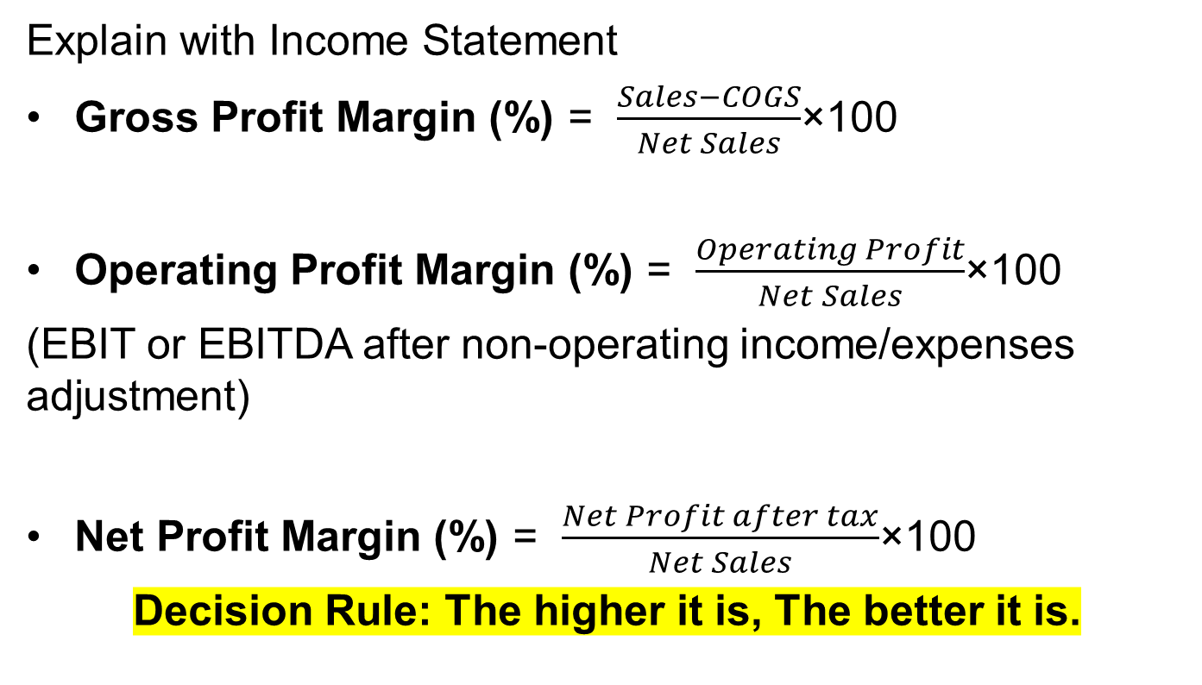
Profitability Ratios: Margin Ratios (Profits wrt Sales)
Explain with Income Statement
Gross Profit Margin (%) = $\frac{Sales−COGS}{Net Sales}$×100
Operating Profit Margin (%) = $\frac{Operating Profit}{Net Sales}$×100
(EBIT or EBITDA after non-operating income/expenses adjustment)
Net Profit Margin (%) = $\frac{Net Profit after tax}{Net Sales}$×100
Decision Rule: The higher it is, The better it is.

Slide 16
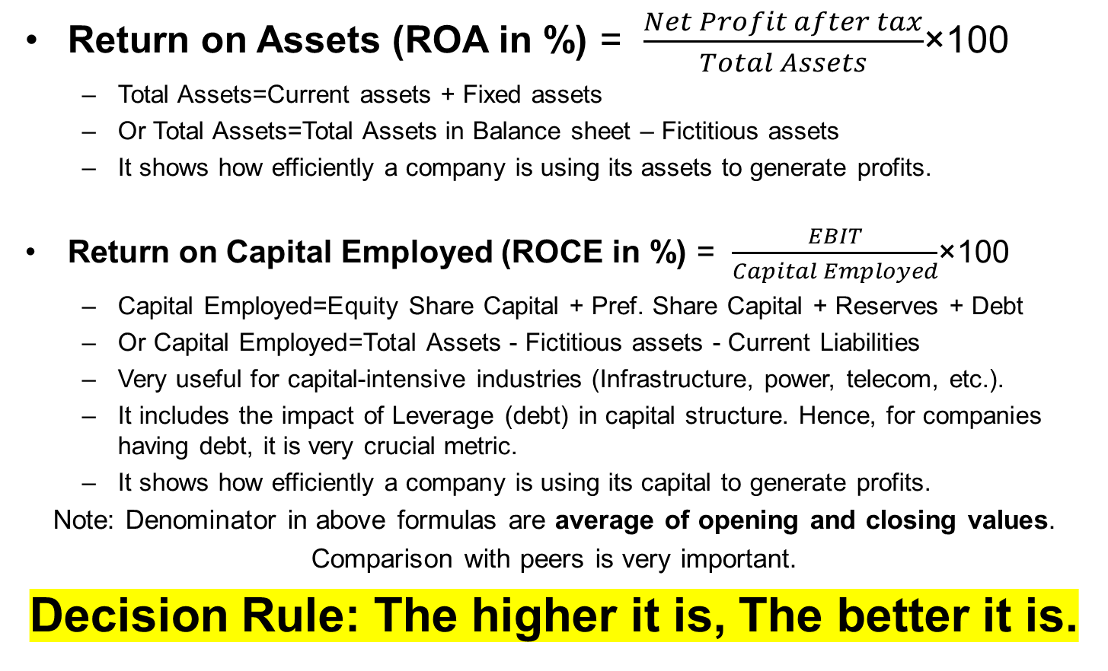
Profitability Ratios: Return Ratios (Profits wrt Capital)
Return on Assets (ROA in %) = $\frac{Net Profit after tax}{Total Assets}$×100
Total Assets=Current assets + Fixed assets
Or Total Assets=Total Assets in Balance sheet – Fictitious assets
It shows how efficiently a company is using its assets to generate profits.
Return on Capital Employed (ROCE in %) = $\frac{EBIT}{Capital Employed}$×100
Capital Employed=Equity Share Capital + Pref. Share Capital + Reserves + Debt
Or Capital Employed=Total Assets - Fictitious assets - Current Liabilities
Very useful for capital-intensive industries (Infrastructure, power, telecom, etc.).
It includes the impact of Leverage (debt) in capital structure. Hence, for companies having debt, it is very crucial metric.
It shows how efficiently a company is using its capital to generate profits.
Note: Denominator in above formulas are average of opening and closing values.
Comparison with peers is very important.
Decision Rule: The higher it is, The better it is.

Slide 17
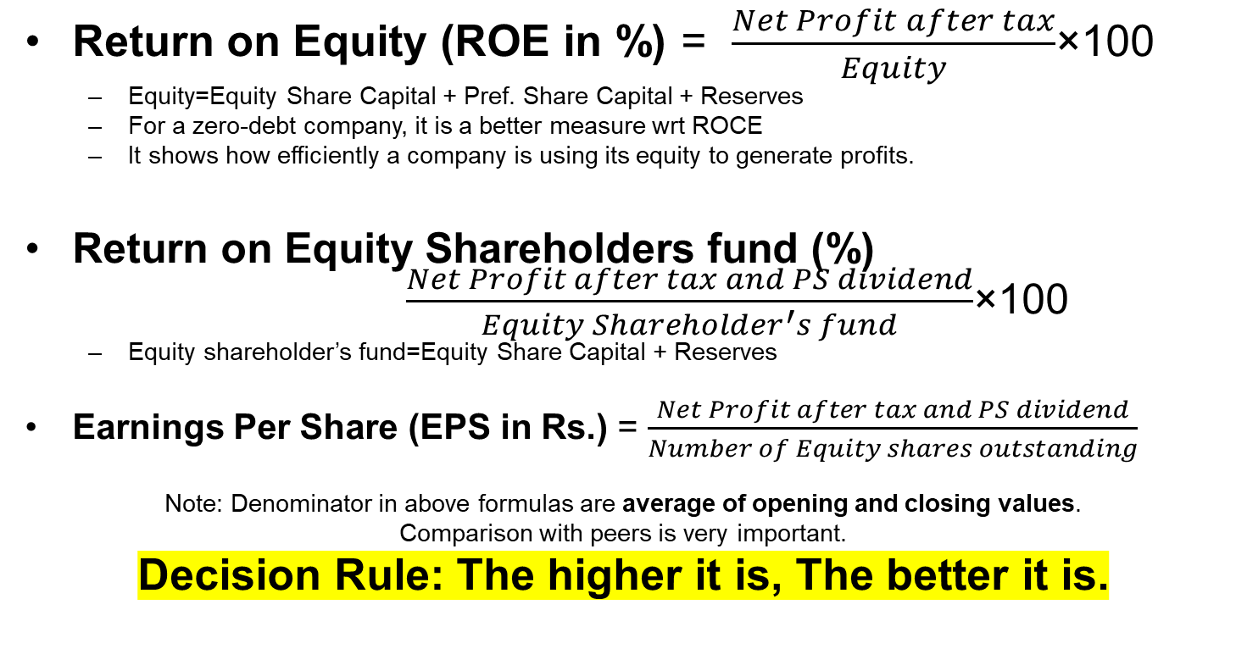
Profitability Ratios: Return Ratios (Return on Investment)
Return on Equity (ROE in %) = $\frac{Net Profit after tax}{Equity}$×100
Equity=Equity Share Capital + Pref. Share Capital + Reserves
For a zero-debt company, it is a better measure wrt ROCE
It shows how efficiently a company is using its equity to generate profits.
Return on Equity Shareholders fund (%) $\frac{Net Profit after tax and PS dividend}{Equity Shareholder^{′}s fund}$×100
Equity shareholder’s fund=Equity Share Capital + Reserves
Earnings Per Share (EPS in Rs.) = $\frac{Net Profit after tax and PS dividend}{Number of Equity shares outstanding}$
Note: Denominator in above formulas are average of opening and closing values.
Comparison with peers is very important.
Decision Rule: The higher it is, The better it is.

Slide 18
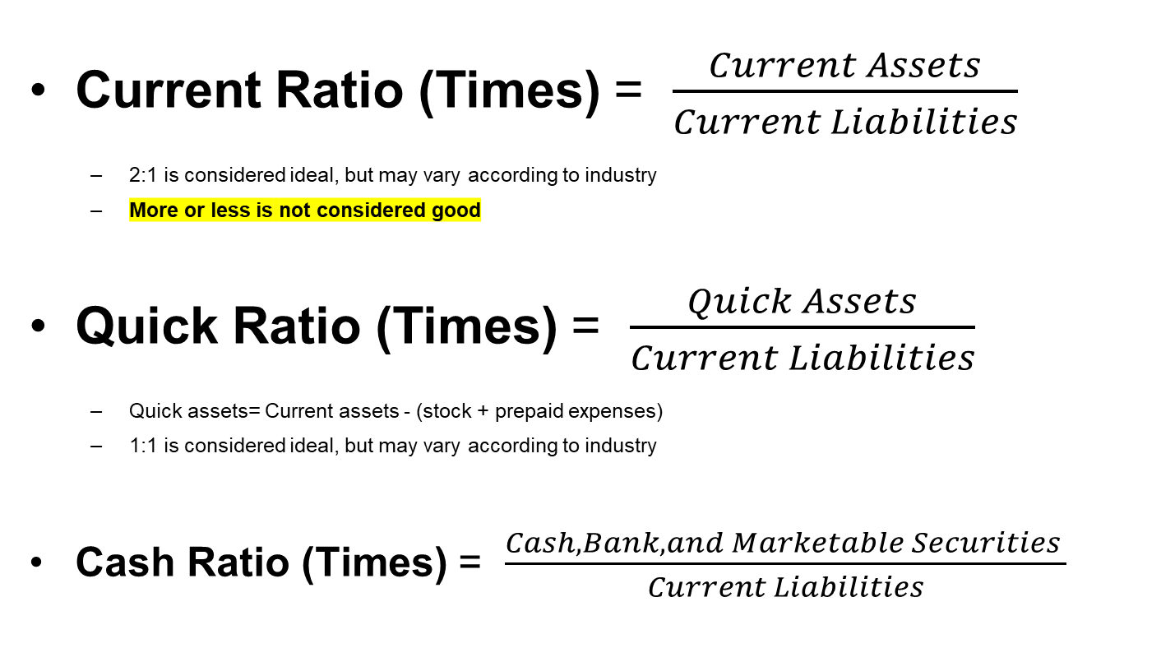
Liquidity Ratios (Short-term financial position)
Current Ratio (Times) = $\frac{Current Assets}{Current Liabilities}$
2:1 is considered ideal, but may vary according to industry
More or less is not considered good
Quick Ratio (Times) = $\frac{Quick Assets}{Current Liabilities}$
Quick assets= Current assets - (stock + prepaid expenses)
1:1 is considered ideal, but may vary according to industry
Cash Ratio (Times) = $\frac{Cash, Bank, and Marketable Securities }{Current Liabilities}$

Slide 19
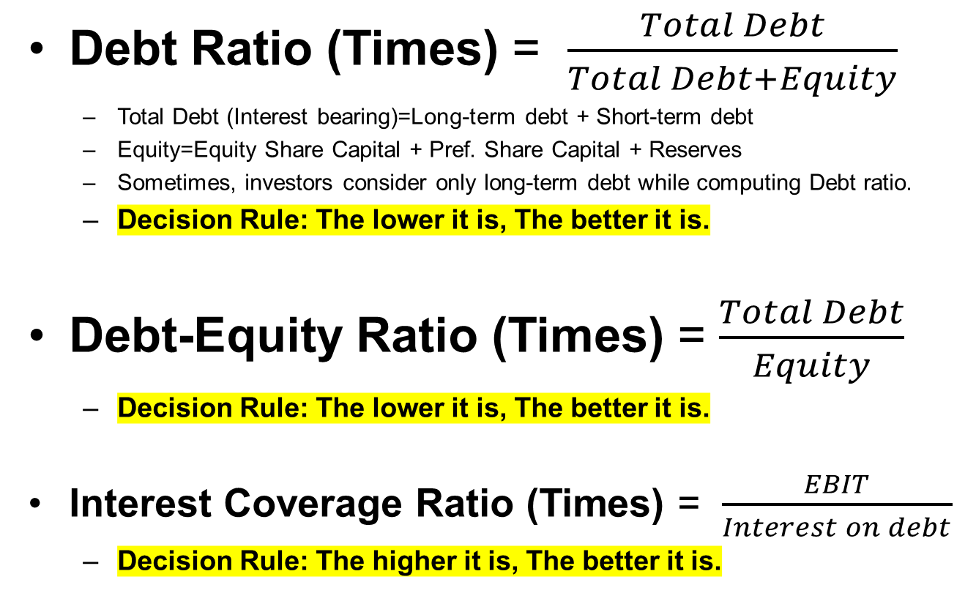
Solvency/Leverage Ratios (Long-term financial position)
Debt Ratio (Times) = $\frac{Total Debt}{Total Debt+Equity}$
Total Debt (Interest bearing)=Long-term debt + Short-term debt
Equity=Equity Share Capital + Pref. Share Capital + Reserves
Sometimes, investors consider only long-term debt while computing Debt ratio.
Decision Rule: The lower it is, The better it is.
Debt-Equity Ratio (Times) = $\frac{Total Debt}{Equity}$
Decision Rule: The lower it is, The better it is.
Interest Coverage Ratio (Times) = $\frac{EBIT}{Interest on debt}$
Decision Rule: The higher it is, The better it is.

Slide 20
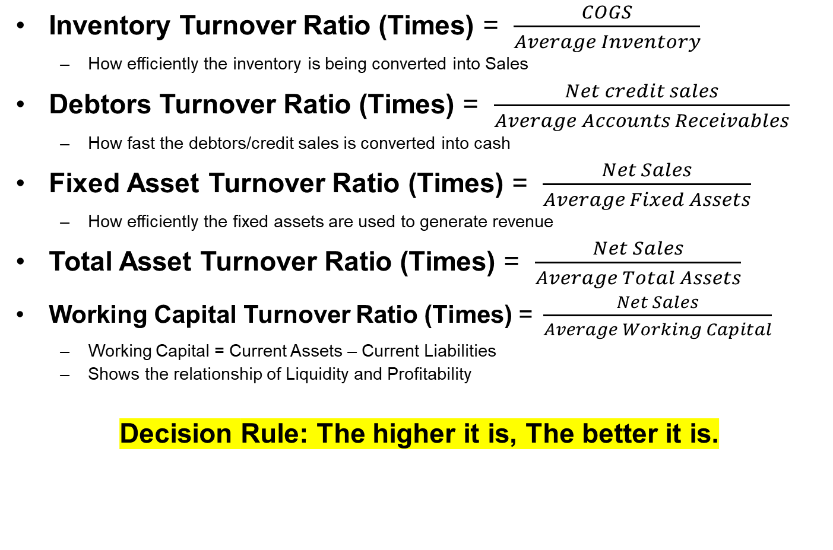
Turnover/Activity/Efficiency Ratios
Inventory Turnover Ratio (Times) = $\frac{COGS}{Average Inventory}$
How efficiently the inventory is being converted into Sales
Debtors Turnover Ratio (Times) = $\frac{Net credit sales}{Average Accounts Receivables}$
How fast the debtors/credit sales is converted into cash
Fixed Asset Turnover Ratio (Times) = $\frac{Net Sales}{Average Fixed Assets}$
How efficiently the fixed assets are used to generate revenue
Total Asset Turnover Ratio (Times) = $\frac{Net Sales}{Average Total Assets}$
Working Capital Turnover Ratio (Times) = $\frac{Net Sales}{Average Working Capital}$
Working Capital = Current Assets – Current Liabilities
Shows the relationship of Liquidity and Profitability
Decision Rule: The higher it is, The better it is.

Slide 21
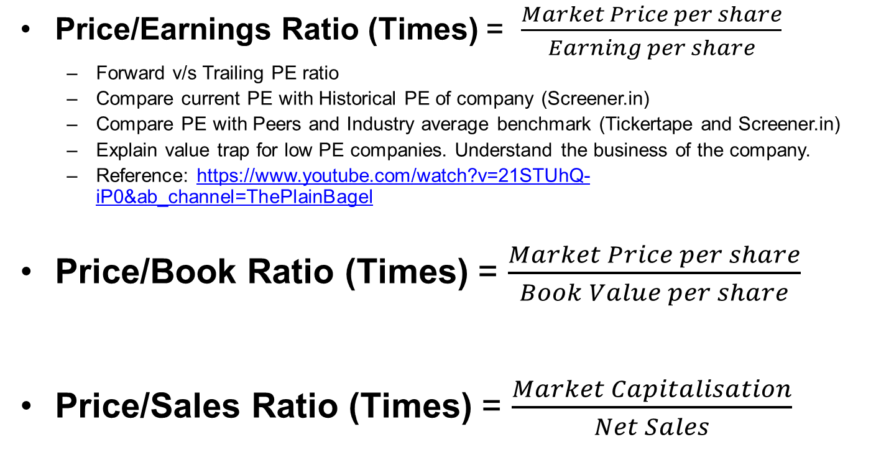
Valuation Ratios
Price/Earnings Ratio (Times) = $\frac{Market Price per share}{Earning per share}$
Forward v/s Trailing PE ratio
Compare current PE with Historical PE of company (Screener.in)
Compare PE with Peers and Industry average benchmark (Tickertape and Screener.in)
Explain value trap for low PE companies. Understand the business of the company.
Reference: https://www.youtube.com/watch?v=21STUhQ-iP0&ab_channel=ThePlainBagel
Price/Book Ratio (Times) = $\frac{Market Price per share}{Book Value per share}$
Price/Sales Ratio (Times) = $\frac{Market Capitalisation}{Net Sales}$

Slide 22
DU PONT Analysis (Two-step)
Sales
Net Profit
Net Profit Margin
-
÷
Expenses
Sales
Return on Assets
X
Sales
Fixed Assets
Total Assets Turnover
÷
+
Total Assets
Current Assets

Slide 23
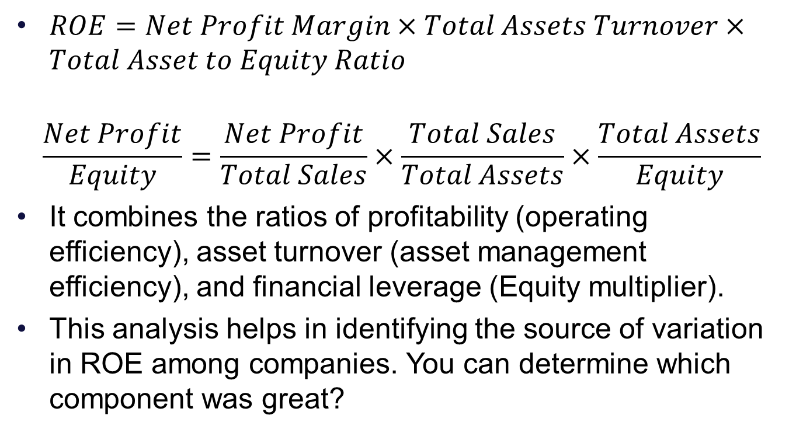
DU PONT Analysis (Three-step)
$ROE=Net Profit Margin×Total Assets Turnover×Total Asset to Equity Ratio$
$$\frac{Net Profit}{Equity}=\frac{Net Profit}{Total Sales}×\frac{Total Sales}{Total Assets}×\frac{Total Assets}{Equity}$$
It combines the ratios of profitability (operating efficiency), asset turnover (asset management efficiency), and financial leverage (Equity multiplier).
This analysis helps in identifying the source of variation in ROE among companies. You can determine which component was great?

Slide 24
Practice (Du Pont)
There are two companies (X and Y) in the cement industry. Both are having same return on equity (ROE), i.e. 20%. These are some numbers regarding these companies:
Mr. Ram wants to invest INR 1,00,000 in only one of these two companies, and he is a risk averse investor. You are supposed to use Du Pont Analysis and let Mr. Ram know which company is better for investment purpose and what is your rationale for such investment?
 | Company X | Company Y
ROE (%) | 20% | 20%
Net Profit (INR) | 200000 | 300000
Total Sales (INR) | 2000000 | 1500000
Total Assets (INR) | 2000000 | 7500000
Equity (INR) | 1000000 | 1500000

Slide 25
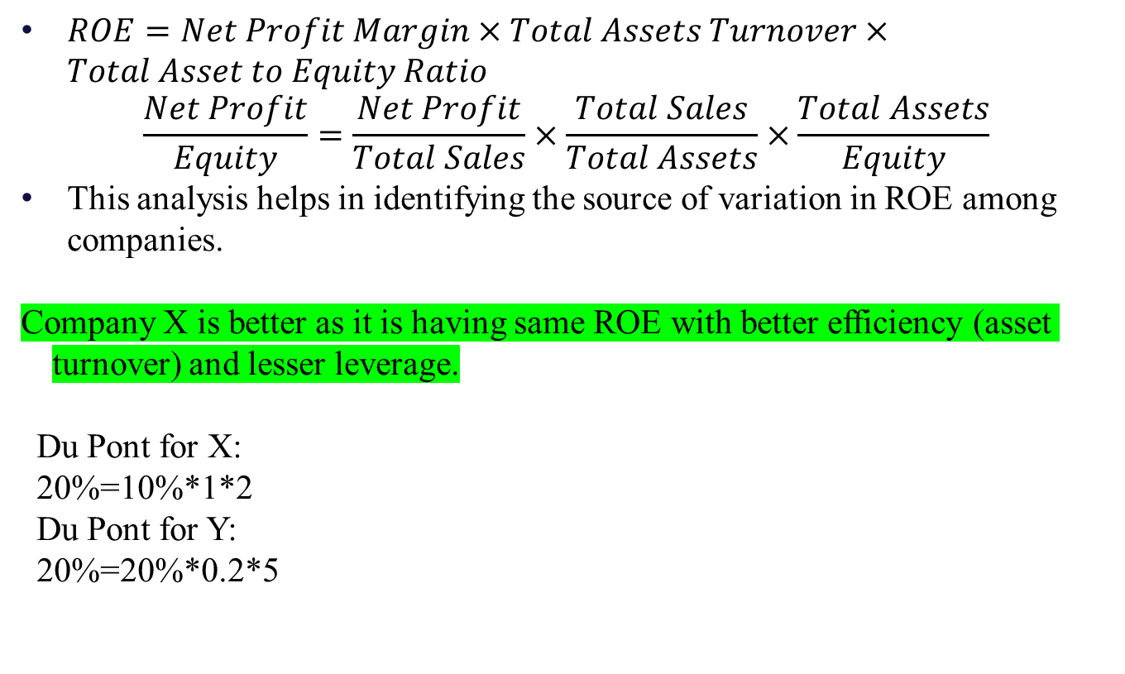
Practice Solution (Du Pont)
$ROE=Net Profit Margin×Total Assets Turnover×Total Asset to Equity Ratio$
$$\frac{Net Profit}{Equity}=\frac{Net Profit}{Total Sales}×\frac{Total Sales}{Total Assets}×\frac{Total Assets}{Equity}$$
This analysis helps in identifying the source of variation in ROE among companies.
Company X is better as it is having same ROE with better efficiency (asset turnover) and lesser leverage.
Du Pont for X:
20%=10%*1*2
Du Pont for Y:
20%=20%*0.2*5

Slide 26
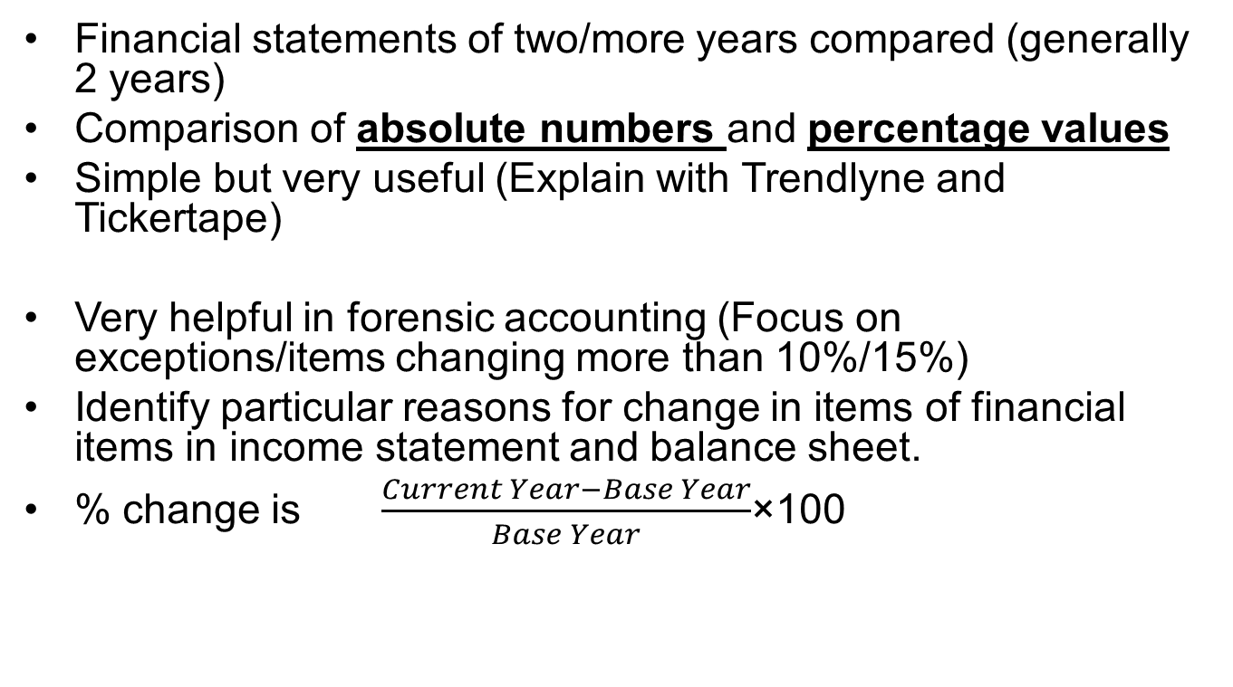
Horizontal Analysis
Financial statements of two/more years compared (generally 2 years)
Comparison of absolute numbers and percentage values
Simple but very useful (Explain with Trendlyne and Tickertape)
Very helpful in forensic accounting (Focus on exceptions/items changing more than 10%/15%)
Identify particular reasons for change in items of financial items in income statement and balance sheet.
% change is $\frac{Current Year−Base Year}{Base Year}$×100

Slide 27
Trend Analysis (Horizontal analysis)
Extension of Horizontal analysis for more than 2 years (Explain with Trendlyne and Tickertape)
Base year is assigned 100 value. The amounts in the following years are expressed as a percentage of the base year value
To identify the growth (CAGR)

Slide 28
Vertical (common-size) Analysis
Generally, financial statements of just one year analysed. (Explain with Tickertape Margin view). However, if required, analysis could be extended to multiple years to get insights.
Common size statements are prepared
Based on total sales (Income statement)
Based on total assets (Balance sheet)
All items of statement are expressed in percentage with respect to a common base (Total sales/assets)

Slide 29
Industry Benchmarking Analysis
Technique to use to compare your business to a competitor business or to businesses in the industry at large.
It can help answer questions like:
Does your business have a competitive advantage?
Are there weaknesses or inefficiencies that we can address and close the gap between your company and competitors?”

Slide 30
THANK YOU!!!

